Slide 1
Meeting Week 12
Last week summary
Simulation
  Results and changes based on these results
Outline ToDo next week

Slide 2
Last week summary
Simulation – Parameter recovery
  Stratified random sampling
  Batching
  Gradient
Augmentation – Additional state

Slide 3
Stratified random sampling
Problem: total trajectory is too long (35001 steps) to train in one pass → solution: split it into segments (8 × 4000 per epoch)
  Divided into 4375 × 8 separate parts, but per epoch only 4000
    This allows to have different starting positions, don’t see the same segment every epoch
Stratified guarantees every part of the trajectory is seen every epoch over pure random

Slide 4
Batching
Multiple shooting
  Batch: each epoch processes all n=8 segments simulated in parallel
Each segment starts from a precomputed state (position + velocity from data)
  Positions are taken directly from q1 (measured). Velocities are not measured they are computed via central differences

Slide 5
Gradient
Gradient computation
  Loss = MSE(predicted positions, measured positions)
  All 8 segments contribute, averaged before parameter updating
Adam optimizer
Notes:
Adam optimizes over the 13 parameters in log space (to guarantee M(Y) is invertible because all parameters > 0 )
Gradient Computation
simulate() rolls out RK4 over each segment with bptt_mode='full' — full backpropagation
through time (BPTT) through all segment_len steps. The gradient flows through simulate →
_build_matrices → _recover_params → log_params (the single trainable nn.Parameter).
Gradient flows back through the RK4 simulation (full BPTT over 4000 steps per segment)
to log_params
Looks at MSE but also looks at how the develops over multiple…
Val for tuning learning rate… -->> stratisfied sampling balab

Slide 6
Requirements
New state should not be measured directly.
Structurally non-absorbable by the rigid baseline
The effect of the added state must be visible enough in the measured signals for the augmentation to detect it
Physically interpretable
Notes:
Hidden from the output
(if I plant o add noise SNR: compare hidden-state contribution to noise
map:

Slide 7
Requirements
New state should not be measured directly.
  Indirect visible through dynamics: We only see the effect of it / it disturbs the measured motion
Structurally non-absorbable by the rigid baseline (hard to quantify)
  The original baseline model can’t fake the effect by changing its parameter values → the baseline would need to add states to imitate it
The effect of the added state must be visible enough in the measured signals for the augmentation to detect it
  Could be quantified before implementing augmentation:
    Relative output contribution compared to total measured motion
    Residual of best re-identified model after refitting the baseline parameters on data
Physically interpretable
  Relevant to the gantry
Notes:
Hidden from the output
(if I plant o add noise SNR: compare hidden-state contribution to noise
map:

Slide 8
Suggestion
Additional Mass Spring Damper attached to payload mass (mh)
  Position and velocity as additional states
  Similar to Jan adding MSD
Notes:
I can justify it with a sensor or camera

Slide 9

Comparison with Jan

Slide 10
Comparison with Jan
With p3 the position of the additional mass - not measured

Slide 11


Slide 13
Note:
Picture is not fully accurate, we define the mass as the relative displacement from mh currently
Will need to add offset

Slide 14

Lagrange-Euler - Garcia

Slide 15

Lagrange-Euler - Garcia

Slide 16
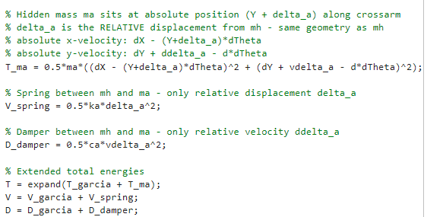
Lagrange-Euler – Additional state
Notes:
Why $T_{ma}$Has No $J_{a}$Term
$m_{a}$is modeled as a point mass — it has no rotational inertia about its own center of mass.
Linear spring: linear spring potential energy
Jan also has linear spring…?

Slide 17
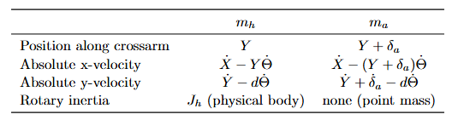
Lagrange-Euler – Additional state
Notes:
Why $T_{ma}$Has No $J_{a}$Term
$m_{a}$is modeled as a point mass — it has no rotational inertia about its own center of mass.
Linear spring: linear spring potential energy
Jan also has linear spring…?

Slide 18
Lagrange-Euler – Additional state
Notes:
Why $T_{ma}$Has No $J_{a}$Term
$m_{a}$is modeled as a point mass — it has no rotational inertia about its own center of mass.
Linear spring: linear spring potential energy
Jan also has linear spring…?

Slide 19
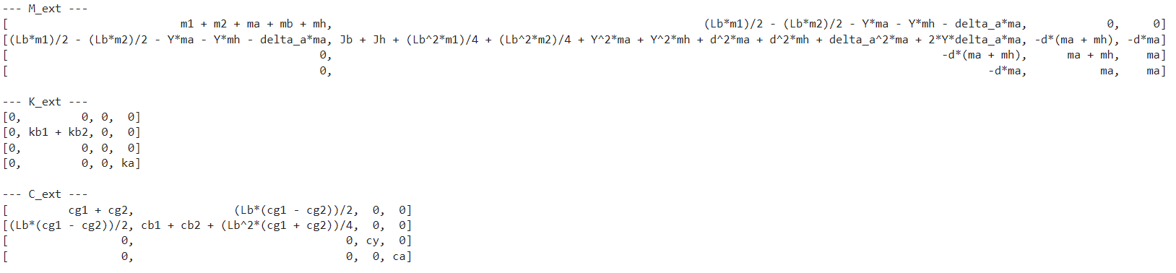
Symbolic toolbox result
4th row and 4th column is the addition of the additional state delta_a

Slide 20
End recap

Slide 21
Simulation
Trajectories
Previous results
Changes based on these results

Slide 22
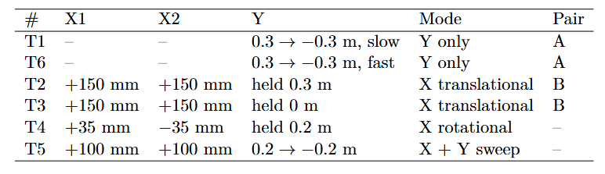
Simulation
Multiple Trajectories
Notes:
How theta is defined, difference
Max formula was 72 mm

Slide 23
Simulation
Multiple Trajectories
Noiseless data
No multisine injected
Notes:
How theta is defined, difference
Max formula was 72 mm

Slide 24
Simulation
Channel normalization
Previously one global sigma per channel:
  Sigma: per-channel std of X1, X2, Y pooled over all 6 trajectories
  Loss: MSE((q1_sim − q1_meas) / σ), normalizing X1, X2, Y to equal weight
New method (no results):
  Normalize per trajectory instead of one global
  So sigma[T1] = [σ_T1_X1, σ_T1_X2, σ_T1_Y]
    Each segment uses its corresponding normalization
(q1 is the measured stage positions)

Slide 25
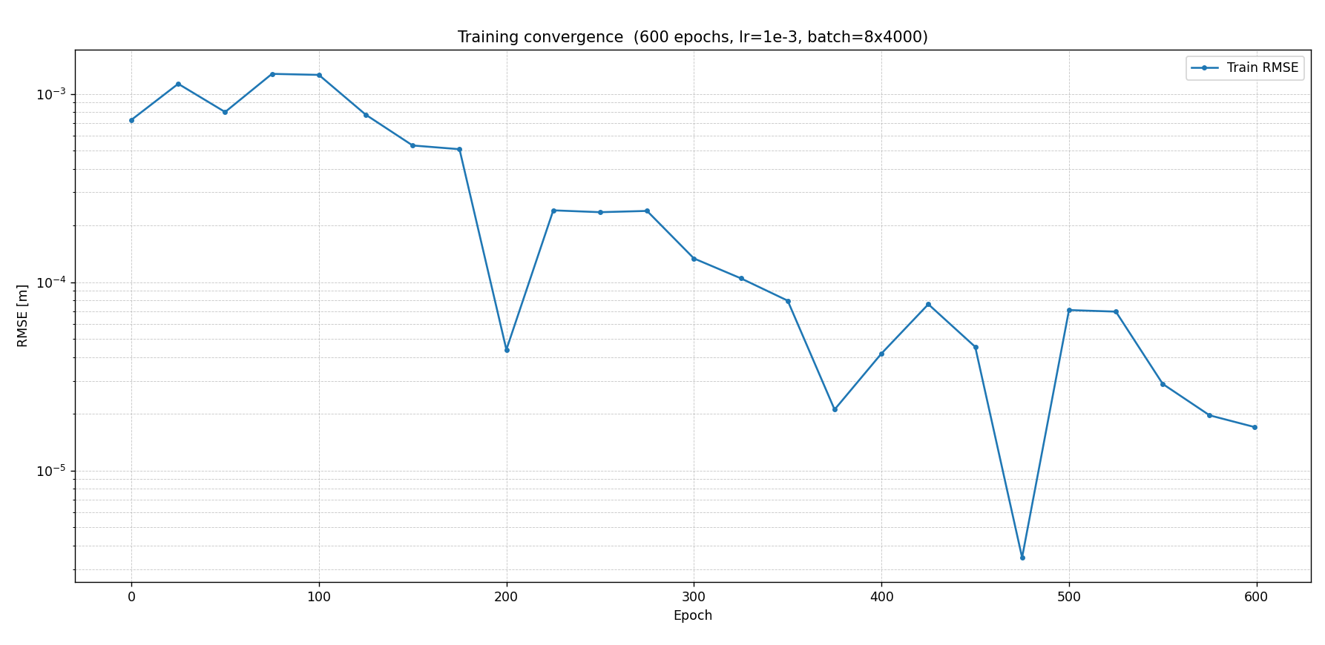

Slide 26
Overal RMSE 6.24e^-4 m
Over all 6 trajectories

Slide 27
Multiple trajectories with varying batches.
No full trajectories evaluation inbetween

Slide 28
Full trajectory evaluation
Instead every x amount of epochs run for all 6 trajectories full evaluation to determine convergence
  Can be done in parallel on the server (using a second GPU)
  Schedule the learning rate based on evaluation
Notes:
Currently no learning rate updates

Slide 29
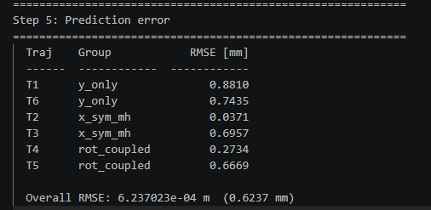
Multiple trajectories with varying batches.
No full trajectories evaluation

Slide 30
Kijken hoe het hier zit met normalisatie in meters dus niet genormaliseerd

Slide 31
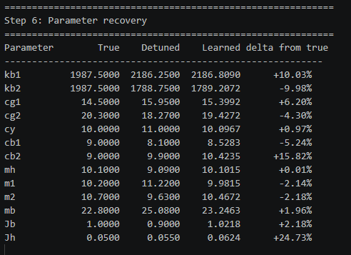
Notes:
Overal result is worse, but parameter recovery overall is better. But that’s mainly due to before one trajectory
Don’t clearly show per channel (X1, X2, and Y) currently

Slide 32
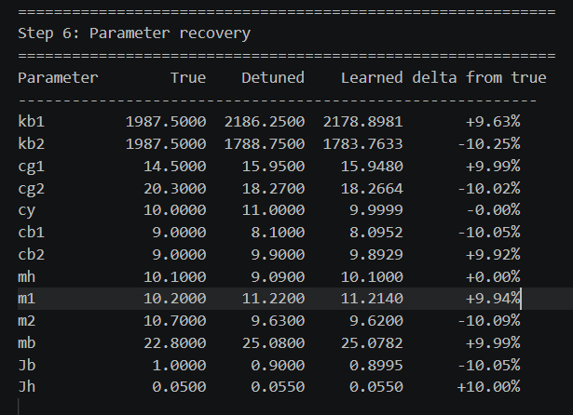
Multiple
One
Notes:
kb1 and kb2 are encouraged to be equal
cb1 and cb2 are encouraged to be equal
Jb and Jh are encouraged to change by the same fractional amount in log-space
Kijken naar sum, hoe accuraat dit is, want voor het model maakt het niet uit

Slide 33
Multiple
One
Multiple trajectories are able to identify more parameters. Previous trajectory was Y-only
Notes:
kb1 and kb2 are encouraged to be equal
cb1 and cb2 are encouraged to be equal
Jb and Jh are encouraged to change by the same fractional amount in log-space

Slide 34
hoe ik het met de sum oplos
kb1 and kb2 are encouraged to be equal
cb1 and cb2 are encouraged to be equal
Jb and Jh are encouraged to change by the same fractional amount in log-space

Slide 35
Current problems
Problem 1 — Dormant channels included in the loss
- On T1/T6, X1 and X2 are suppressed by the feedback controller but contribute to the MSE
- The optimizer receives gradient from controller suppression dynamics, not plant physics
- Parameters are pulled toward values that explain controller behaviour, not physical
parameters
Problem 2 — Global sigma dilutes Y, inflates X
- sigma[Y] is computed from all 6 trajectories including T2/T3/T4 where Y is constant →
sigma[Y] is artificially small → Y is over-weighted in the loss
- sigma[X1] is computed from all 6 trajectories including T1/T6 where X1 is near-zero →
sigma[X1] is artificially large → X1 is under-weighted on trajectories where it is actually
active
Problem 3 — Within-trajectory amplitude imbalance
- On T5 (X + Y both active), if Y sweeps much more than X1/X2, Y dominates the loss
- Parameters primarily identified by X motion (m1, m2, cg1, cg2) are undertrained relative
to Y-related parameters (mh, cy)
Problem 4 — Cross-trajectory amplitude imbalance
- Trajectories with the same active channels can have very different amplitudes (T1
conservative vs T6 aggressive Y sweep)
- Global sigma cannot capture this: T6 segments always dominate T1 segments in the loss even
though both are Y-only
Problem 5 — Denominator is inconsistent across segments
- Different segments have different numbers of active channels (T1: 1 active, T2: 2 active,
T5: 3 active)
- A fixed denominator gives unequal weight per active channel-step across trajectory groups
- No single global denominator is correct for all segments simultaneously
Problem 6 — Adam sees inconsistent loss scale across batches
- Batch composition varies (different mixes of trajectory groups)
- Without per-segment normalization, the loss magnitude depends on which groups appear in
the batch
- Adam's second moment estimate v_t cannot stabilize → learning rate adaptation is
unreliable

Slide 36
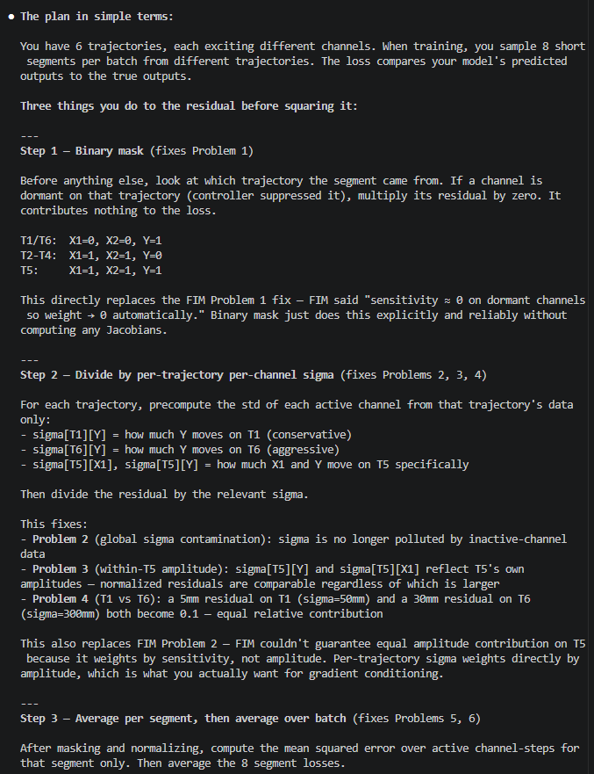
Stepwise solution

Slide 37
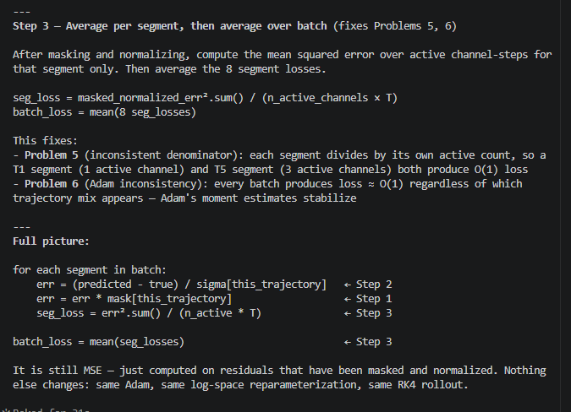

Slide 38
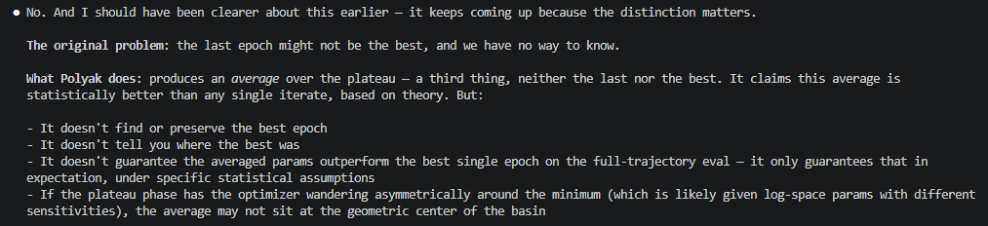
Polyak-Ruppert iterate averaging
ReduceLROnPlateau.
Mainly useful when noise dominates.

Slide 39
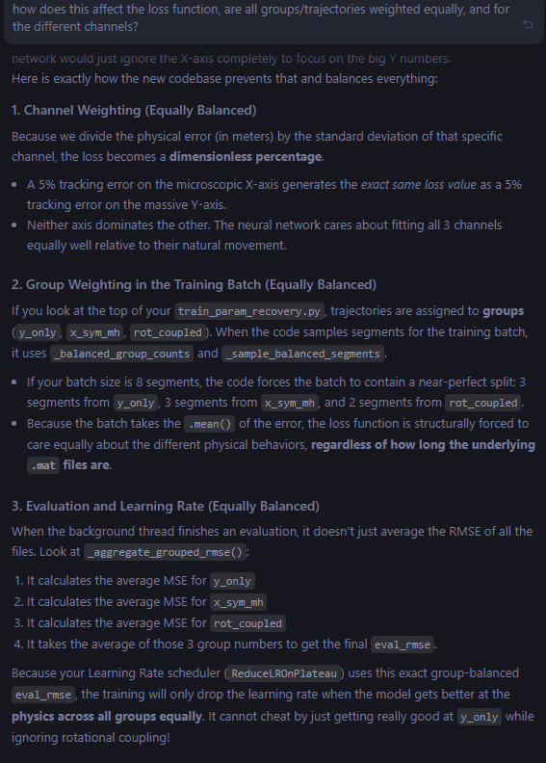
New normalization

Slide 40
Y is coupled through
This moves X also

Slide 41
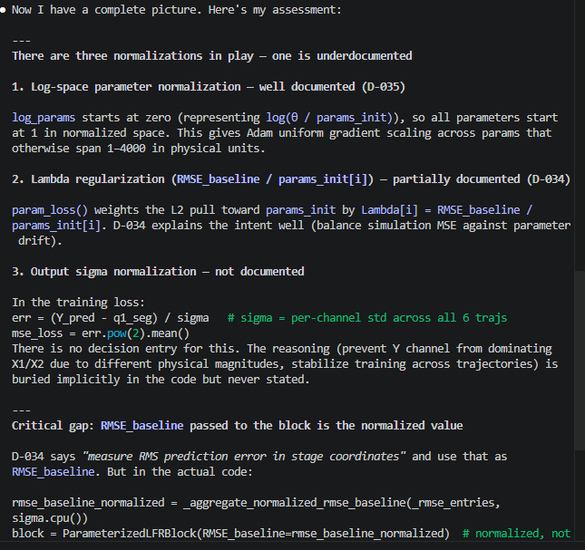
Normalizations

Slide 42
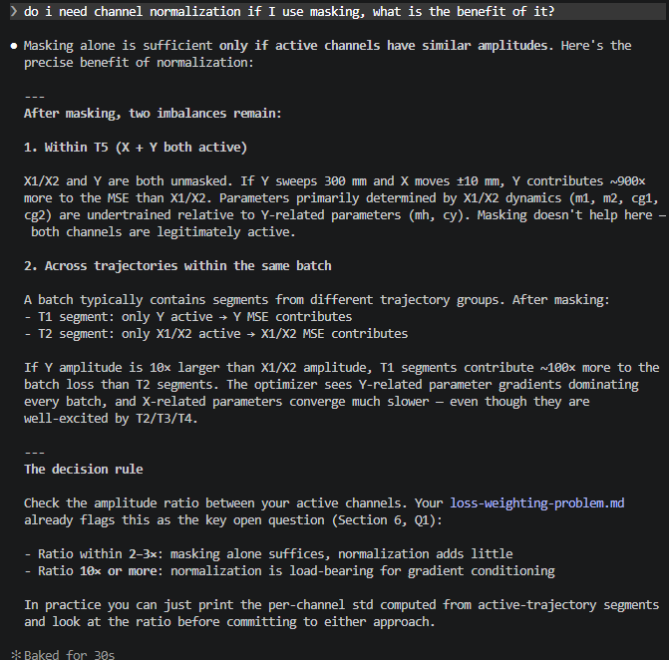
Purpose of normalization

Slide 43
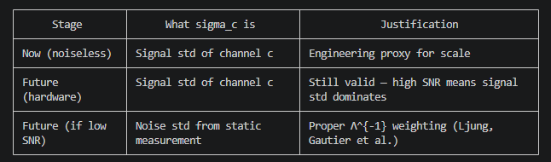
Future proof for noise

Slide 44
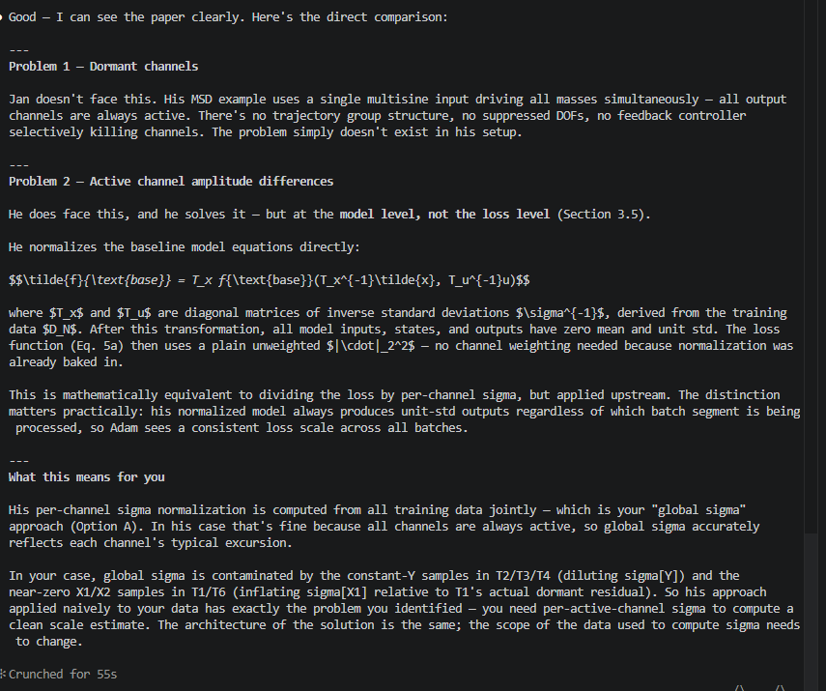
How Jan faces normalization problem

Slide 45
Fisher Information Matrix
Problem different channels should be set to 0 for
How to combine with normalization??
1. Computed at detuned initialization
2. Could recompute periodically
3. Augmentation adds cost

Slide 46
Scheduler
ReduceLROnPlateau fixed on eval instead of “noisy” train MSE
Move scheduler to use eval instead of train, better fitted to noise between batches
Notes:
When run in parallel a bit of delay for the learning rate scheduler

Slide 47
Kijken naar hoe nu werkt met log voor parameters in combinatie met alles

Slide 48
Action point 1
You should have a Gantt-chart or some other planning with what should be the next steps in the research.
Questions can also be put here
Some figure showing the result achieved like a plot or some theory.
When applicable, the same as will go in final report. Otherwise just take screenshots from relevant papers.

Slide 49
Question 1
If a question needs to be answered. Make clear here what the problem/question is that needs to be answered. Questions can always be asked outside the meeting, but we may say prepare to explain what you really mean.
Some figure explaining the concept
When applicable, the same as will go in final report. Otherwise just take screenshots from relevant papers.

Slide 50
Question 1
Does adding the forces to the loss help/smart or bad for augmentation phase
loss += alpha * MSE(M(Y)*q_ddot + C*q_dot + K*q, u_q1)

Slide 51
Question 1
Comment from Roland:
For the additional state need additional input, was this only about giving it physical meaning?
With p3 the position of the additional mass - not measured

Slide 52
Binary masks?
Questions roland and answers, but a bit vague

Slide 53
Outline next week
Validate additional state with simscape
Simulation ensure proper identification for parameter recovery
Add multisine for identification to the trajectories
Compare current trajectories with García’s

Slide 54
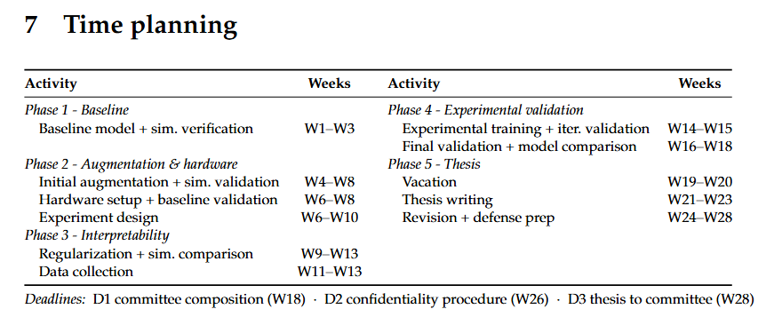
Planning – Week 4

Slide 55
Planning – Week 4

